Slide 1
Automating the Repetitive Routines
by Nuriddin Tojiboyev

Slide 2
Automation
Work Routine
Steps of Routine
Data Needs of Routine
Defined Tasks of the Routine
Standardized Data Formats
Automated Work Routines

Slide 3
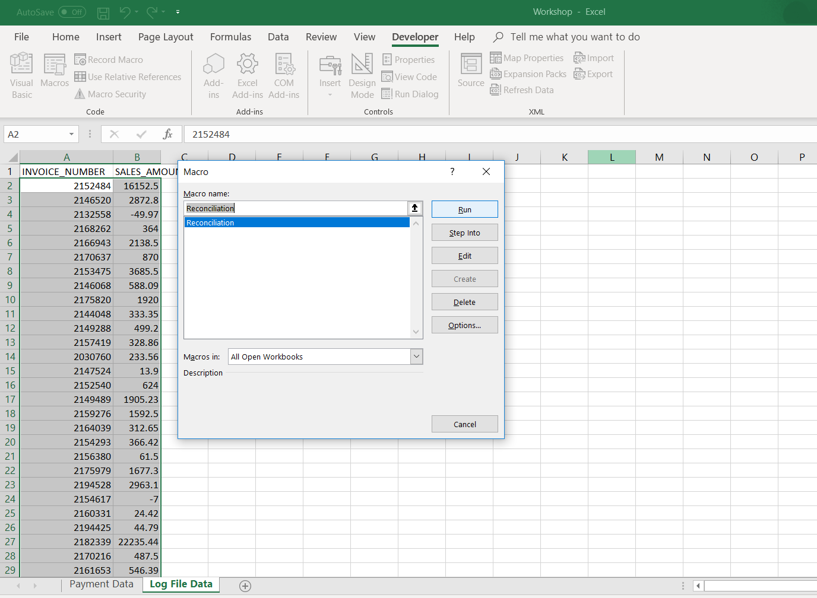
Excel Macros

Slide 4
Excel Macros
Easy to use
Very strict table format requirements
Confined to Excel

Slide 5
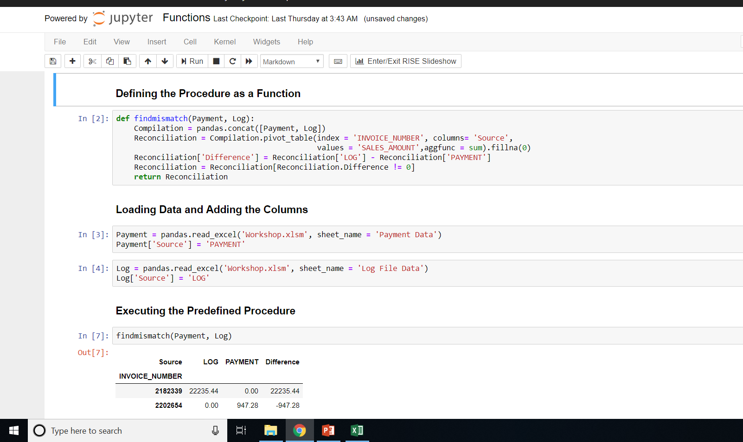
Pandas Library of Python

Slide 6
Pandas Library of Python
Requires programming knowledge
Less strict table format requirement
Confined to programming language

Slide 7
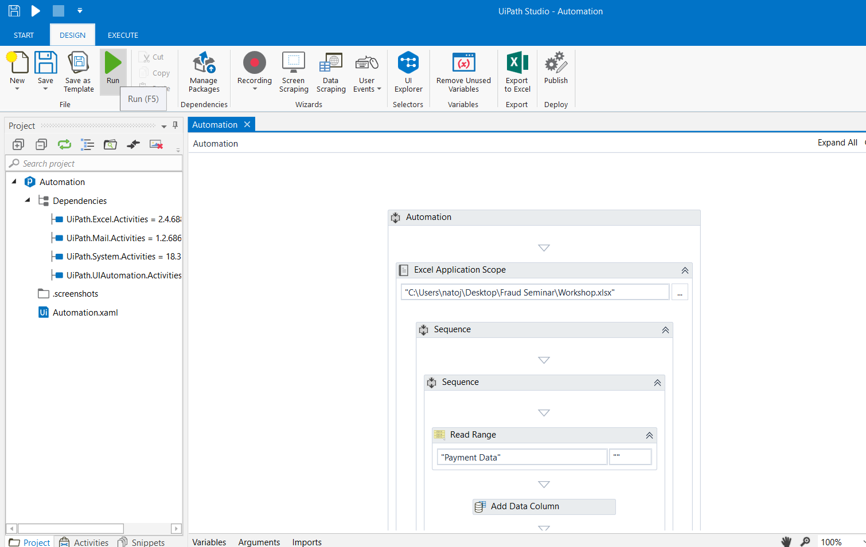
UiPath – Robotic Process Automation

Slide 8
UiPath – Robotic Process Automation
Requires some training
Strict table format requirement
Can be used any application

